Slide 1
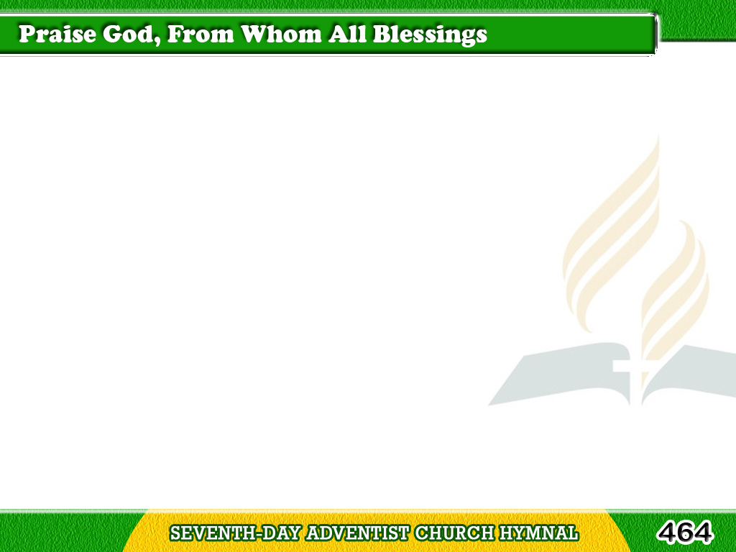
1/1
Praise God, from whom
all blessings flow;
Praise Him, all creatures
here below;
Tagalog
Version

Slide 2
1/1
Praise Him above,
ye heavenly host;
Praise Father, Son,
and Holy Ghost. Amen
Tagalog
Version

